Slide 1
Level 4/5 Group 5
Joseph Barber, Bethany Cowle,
Courtney-Jade Pearson, Henry Smith

Slide 2
Emotion 1: Monachopsis
BC

Slide 3
Emotion 2: Onism
HS

Slide 4
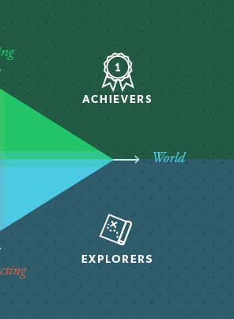
Target Demographic
Bartle’s taxonomy of Player Types: Achievers and Explorers
Age 16-30
Gender: Male and Female
CP

Slide 5
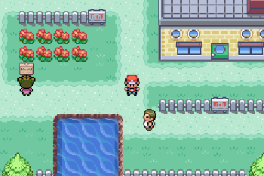
Genre/Style
Puzzle
Strategy
Angled top-down perspective
BC

Slide 6
Narrative
HS

Slide 7
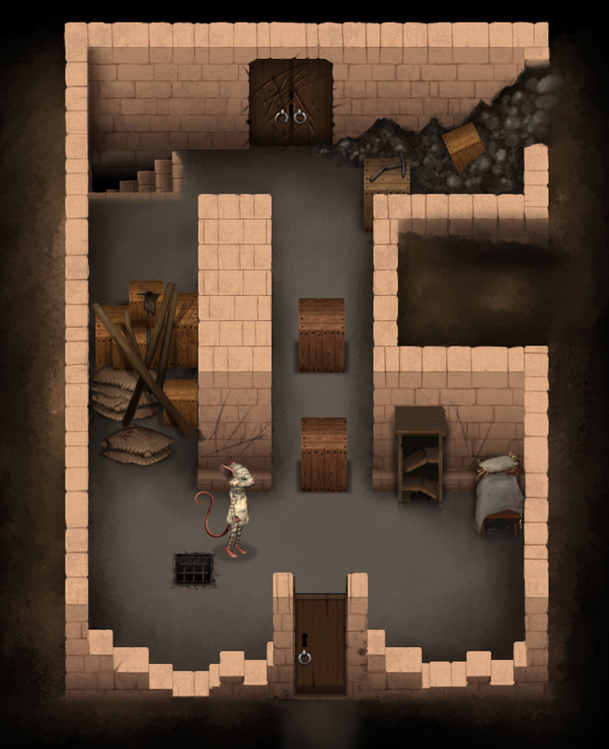

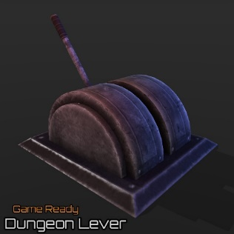
Mechanics: What does the player do?
Walk
Take control of NPCs
Operate objects Key/locks Switches/levers
JB

Slide 8
Unique Selling Point
Unravel narrative through gameplay
Take control of NPCs in the game world
Access different mechanics upon taking over an NPC
JB

Slide 9
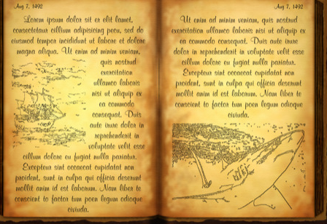


Player Rewards
Collect diary memories
Health Hearts
Keys
Over time, piece together narrative.
CP

Slide 10
Moodboards and Artstyle
HS

Slide 11
Bibliography

